Slide 1
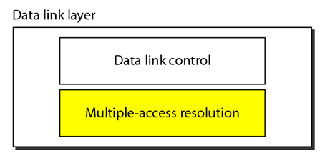
Data Link Layer
We can consider the data link layer as two sublayers.
The upper sublayer is responsible for data link control, and
The lower sublayer is responsible for resolving access to the shared media.
If the channel is dedicated, we do not need the lower sublayer.

Slide 2
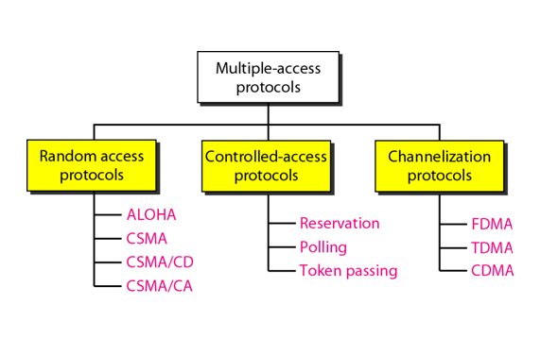
Taxonomy of multiple-access protocols

Slide 3
Random Access
In random access or contention methods, no station is superior to another station and none is assigned the control over another.
At each instance, a station that has data to send uses a procedure defined by the protocol to make a decision on whether or not to send.

Slide 4
Cont.
Two features give this method its name.
First, there is no scheduled time for a station to transmit. Transmission is random among the stations. That is why these methods are called random access.
Second, no rules specify which station should send next. Stations compete with one another to access the medium. That is why these methods are also called contention methods.

Slide 5
Cont.
In a random access method, each station has the right to the medium without being controlled by any other station.
However, if more than one station tries to send, there is an access collision and the frames will be either destroyed or modified.
To avoid access conflict or to resolve it when it happens, each station follows a procedure that answers the following questions:
When can the station access the medium?
What can the station do if the medium is busy?
How can the station determine the success or failure of the transmission?
What can the station do if there is an access conflict?

Slide 6
Cont.
The random access methods evolved from a very interesting protocol known as ALOHA, which used a very simple procedure called multiple access (MA).
The method was improved with the addition of a procedure that forces the station to sense the medium before transmitting. This was called carrier sense multiple access.
This method later evolved into two parallel methods: carrier sense multiple access with collision detection (CSMA/CD) and carrier sense multiple access with collision avoidance (CSMA/CA).
CSMA/CD tells the station what to do when a collision is detected. CSMA/CA tries to avoid the collision.

Slide 7
ALOHA
ALOHA, the earliest random access method.
It is obvious that there are potential collisions in this arrangement.
The medium is shared between the stations. When a station sends data, another station may attempt to do so at the same time.
The data from the two stations collide.

Slide 8
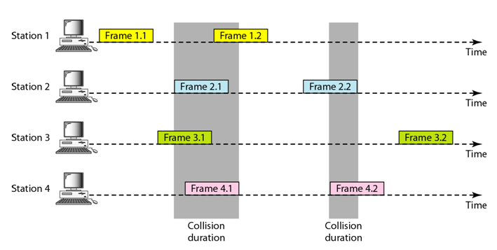
ALOHA-Cont.

Slide 9
ALOHA-Cont.
There are four stations that contend with one another for access to the shared channel.
In figure each station sends two frames; there are a total of eight frames on the shared medium.
Some of these frames collide because multiple frames are in contention for the shared channel.
Only two frames survive: frame 1.1 from station 1 and frame 3.2 from station 3. We need to mention that even if one bit of a frame coexists on the channel with one bit from another frame, there is a collision and both will be destroyed.

Slide 10
ALOHA-Cont.
It is obvious that we need to resend the frames that have been destroyed during transmission.
The pure ALOHA protocol relies on acknowledgments from the receiver.
When a station sends a frame, it expects the receiver to send an acknowledgment.
If the acknowledgment does not arrive after a time-out period, the station assumes that the frame (or the acknowledgment) has been destroyed and resends the frame.
A collision involves two or more stations. If all these stations try to resend their frames after the time-out, the frames will collide again.

Slide 11
ALOHA-Cont.
Pure ALOHA dictates that when the time-out period passes, each station waits a random amount of time before resending its frame.
The randomness will help avoid more collisions. We call this time the back-off time T_{B}.
Pure ALOHA has a second method to prevent congesting the channel with retransmitted frames.
After a maximum number of retransmission attempts K_{max} a station must give up and try later.

Slide 12
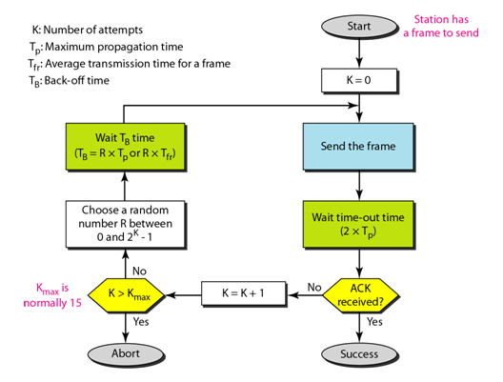
ALOHA-Cont.

Slide 13
ALOHA-Cont.
The time-out period is equal to the maximum possible round-trip propagation delay, which is twice the amount of time required to send a frame between the two most widely separated stations (2 x T_{p}).
The back-off time T_{B} is a random value that normally depends on K (the number of attempted unsuccessful transmissions).
The formula for T_{B} depends on the implementation.

Slide 14
ALOHA-Cont.
One common formula is the binary exponential back-off. In this method, for each retransmission, a multiplier in the range 0 to 2^{K} - 1 is randomly chosen and multiplied by Tp (maximum propagation time) or T_{fr} (the average time required to send out a frame) to find T_{B.}
Note that in this procedure, the range of the random numbers increases after each collision.
The value of K_{max} is usually chosen as 15.

Slide 15
Example
The stations on a wireless ALOHA network are a maximum of 600 km apart. If we assume that signals propagate at 3 × 10⁸ m/s, we find
T_{p} = (600 × 10³ ) / (3 × 10⁸ ) = 2 ms.
Now we can find the value of T_{B} for different values of K.
Solution
For K = 1, the range is {0, 1}. The station needs to generate a random number with a value of 0 or 1. This means that T_{B} is either 0 ms (0 × 2) or 2 ms (1 × 2), based on the outcome of the random variable.

Slide 16
Solution-Cont.
For K = 2, the range is {0, 1, 2, 3}. This means that T_{B} can be 0, 2, 4, or 6 ms, based on the outcome of the random variable.
For K = 3, the range is {0, 1, 2, 3, 4, 5, 6, 7}. This means that T_{B} can be 0, 2, 4, . . . , 14 ms, based on the outcome of the random variable.

Slide 17
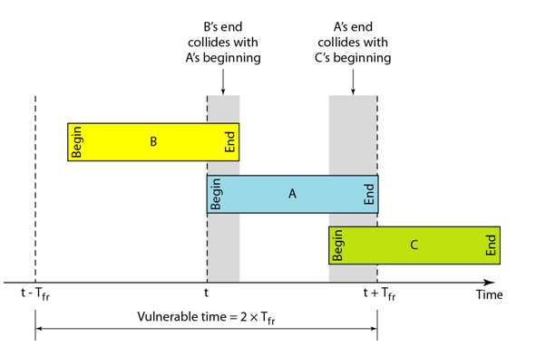
Vulnerable time for pure ALOHA protocol
Let us find the length of time, the vulnerable time that is if frame A is send, under what conditions will the frame arrive intact?
We assume that the stations send fixed-length frames with each frame taking T_{fr} to send.

Slide 18
Cont.
Station A sends a frame at time t. Now imagine station B has already sent a frame between (t - T_{fr}) and t.
This leads to a collision between the frames from station A and station B.
The end of B's frame collides with the beginning of A's frame.
On the other hand, suppose that station C sends a frame between t and t + T_{fr} .
Here, there is a collision between frames from station A and station C. The beginning of C's frame collides with the end of A's frame.
Looking at Figure, we see that the vulnerable time, during which a collision may occur in pure ALOHA, is 2 times the frame transmission time.
Pure ALOHA vulnerable time = 2 x T_{fr}

Slide 19
Example
A pure ALOHA network transmits 200-bit frames on a shared channel of 200 kbps. What is the requirement to make this frame collision-free?
Solution
Average frame transmission time T_{fr} is 200 bits/200 kbps or 1 ms. The vulnerable time is 2 × 1 ms = 2 ms. This means no station should send later than 1 ms before this station starts transmission and no station should start sending during the one 1-ms period that this station is sending.

Slide 20
Slotted ALOHA
Slotted ALOHA was invented to improve the efficiency of pure ALOHA
In slotted ALOHA we divide the time into slots of T_{fr} and force the station to send only at the beginning of the time slot.
Because a station is allowed to send only at the beginning of the synchronized time slot, if a station misses this moment, it must wait until the beginning of the next time slot.
This means that the station which started at the beginning of this slot has already finished sending its frame.
Of course, there is still the possibility of collision if two stations try to send at the beginning of the same time slot.

Slide 21
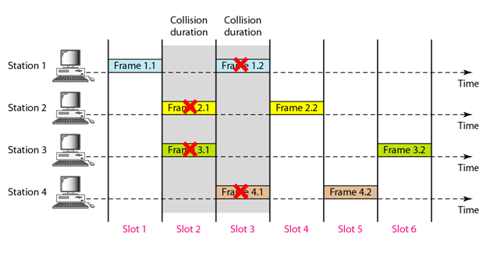
Slotted ALOHA-Cont.
However, the vulnerable time is now reduced to one-half, equal to T_{fr}.
Slotted ALOHA vulnerable time = T_{fr}.

Slide 22
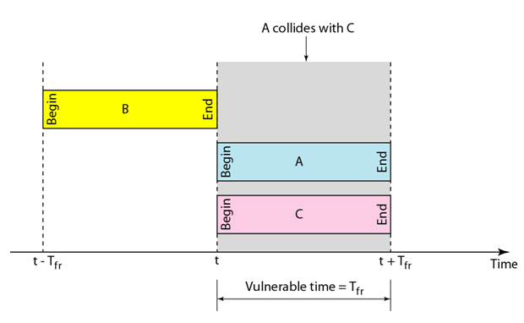
Vulnerable time for slotted ALOHA protocol

Slide 23
Carrier Sense Multiple Access (CSMA)

Slide 24
Introduction
The chance of collision can be reduced if a station senses the medium before trying to use it.
Carrier sense multiple access (CSMA) requires that each station first listen to the medium (or check the state of the medium) before sending.
In other words, CSMA is based on the principle "sense before transmit" or "listen before talk.”

Slide 25
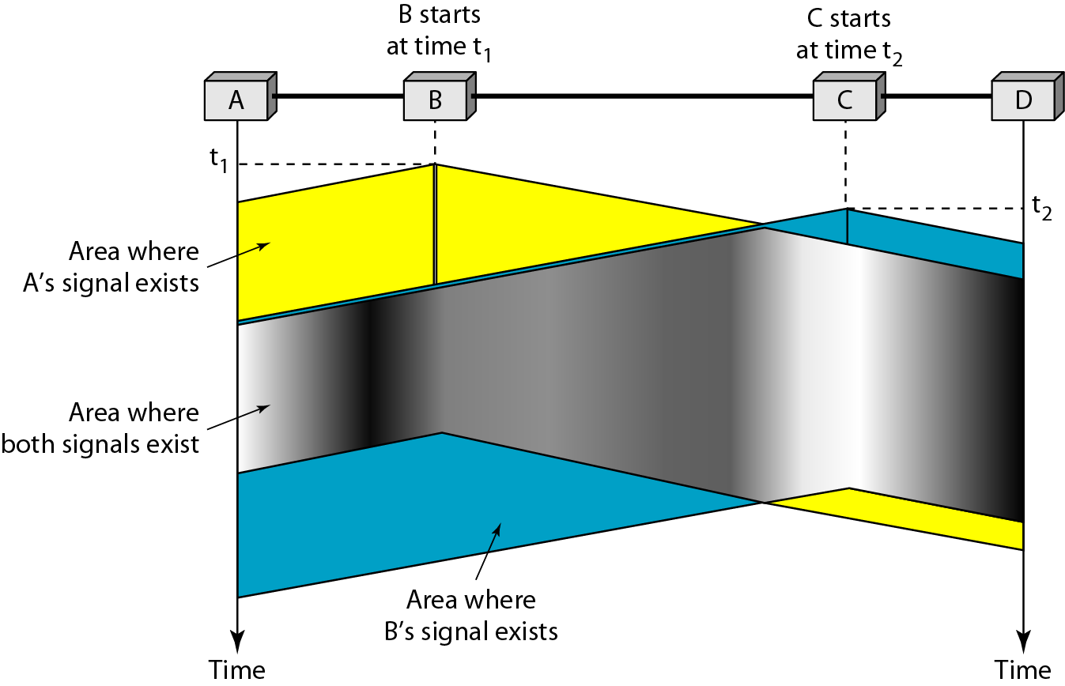
Cont.
CSMA can reduce the possibility of collision, but it cannot eliminate it. The reason for this is shown in Figure below, a space and time model of a CSMA network. Stations are connected to a shared channel (usually a dedicated medium).

Slide 26
Cont.
The possibility of collision still exists because of propagation delay; when a station sends a frame, it still takes time (although very short) for the first bit to reach every station and for every station to sense it.

Slide 27
Cont.
At time t1 station B senses the medium and finds it idle, so it sends a frame. At timet2 (t2>t1)station C senses the medium and finds it idle because, at this time, the first bits from station B have not reached station C. Station C also sends a frame. The two signals collide and both frames are destroyed.

Slide 28
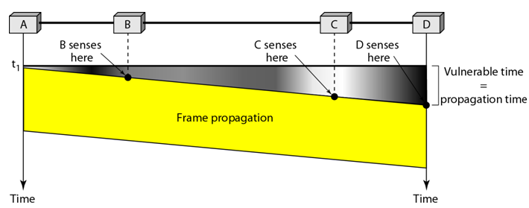
Vulnerable time in CSMA

Slide 29
Cont.
The vulnerable time for CSMA is the propagation time Tp .This is the time needed for a signal to propagate from one end of the medium to the other.
When a station sends a frame, and any other station tries to send a frame during this time, a collision will result.
But if the first bit of the frame reaches the end of the medium, every station will already have heard the bit and will refrain from sending.
Figure shows the worst case The leftmost station A sends a frame at time t₁ which reaches the rightmost station D at time t₁ + T_{p} . The gray area shows the vulnerable area in time and space.

Slide 30
Persistence Methods
What should a station do if the channel is busy? What should a station do if the channel is idle? Three methods have been devised to answer these questions:
The I-persistent method,
The nonpersistent method,
And the p-persistent method.

Slide 31
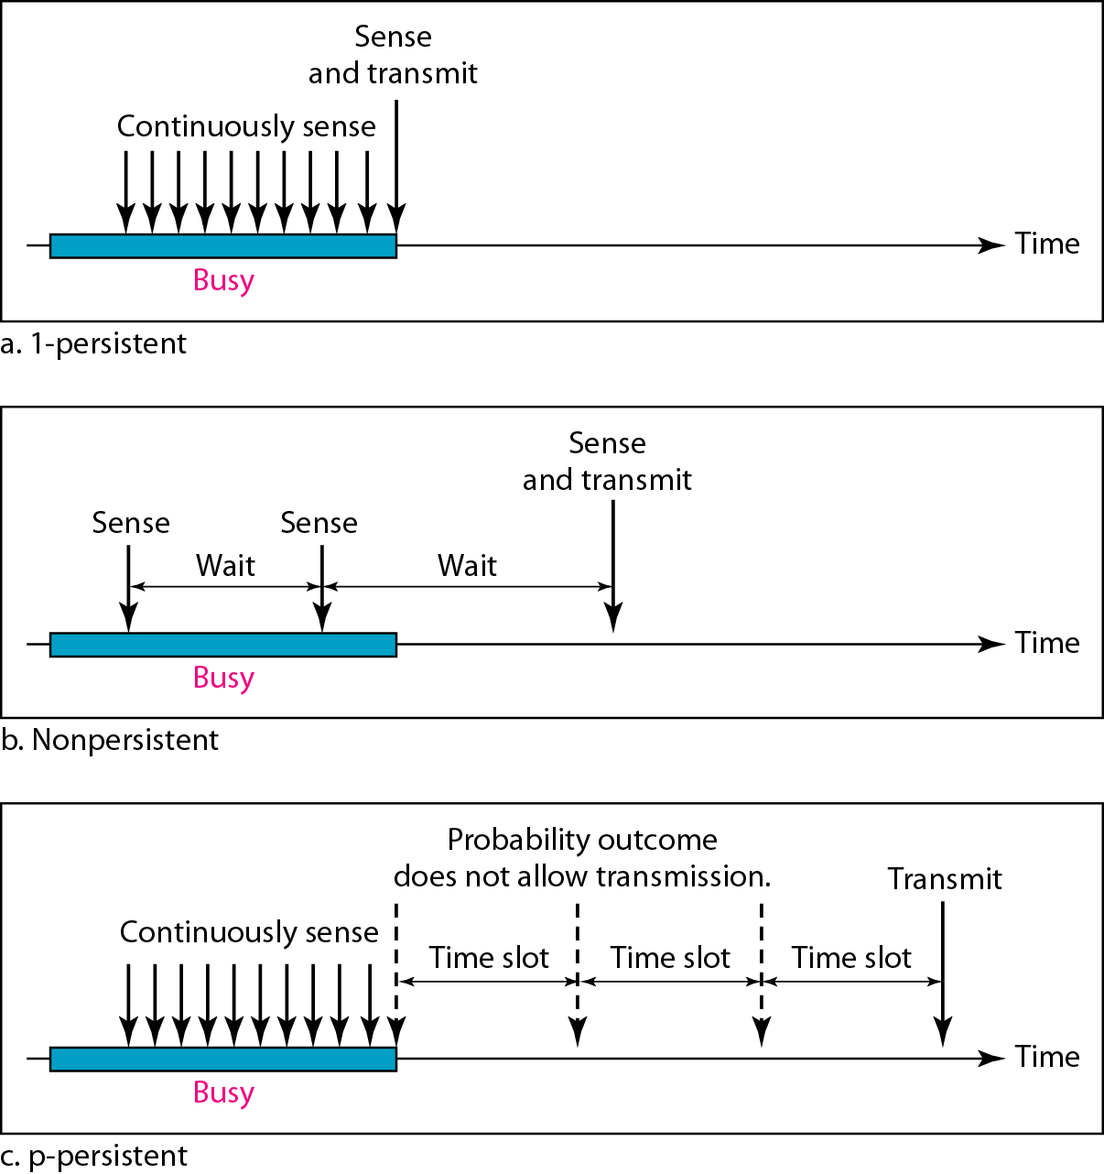
The I-Persistence Methods
The I-persistent method is simple and straightforward. In this method, after the station finds the line idle, it sends its frame immediately.
This method has the highest chance of collision because two or more stations may find the line idle and send their frames immediately.

Slide 32
Nonpersistent method
In the nonpersistent method, a station that has a frame to send senses the line.
If the line is idle, it sends immediately.
If the line is not idle, it waits a random amount of time and then senses the line again.
The nonpersistent approach reduces the chance of collision because it is unlikely that two or more stations will wait the same amount of time and retry to send simultaneously.
However, this method reduces the efficiency of the network because the medium remains idle when there may be stations with frames to send.

Slide 33
P-persistent method
The p-persistent approach combines the advantages of the other two strategies.
It reduces the chance of collision and improves efficiency.

Slide 34
p-persistent method

